Slide 1
3o Lykeio Alimou Business Plan CHOROS FOR THE

Slide 2
MISSION STATEMENT
Provide service to people in need (food, clothes, medication)
Call other people of good will to do the same
Advocate justice for homeless people
Fight poverty in our country

Slide 3
SWOT ANALYSIS
Strengths:
Innovative idea and campaigns
Clearly defined goals and values
Volunteers
Weaknesses:
Non profit company
Hard covering of expenses
Huge amount of homeless people (30.000+)
Opportunities:
Non profit companies are open to grants
Making deals with other services and organization
Threats:
Vulnerability to economical crisis
Community support and acceptance

Slide 4
PROBLEMS AND OPPORTUNITIES
Problems:
Huge demand of products and services
Economical difficulties
Opportunities:
Cooperate with well-known firms
Make profitable deals with investors
Advertise our company from our deals

Slide 5
GOALS AND OBJECTIVES
Being open to society
Paying attention to our credibility
Correct management of our budget
Forecasting monthly input and output
Sign channel partners
Help many people in need within 3-5 years
Become known to our nation
Build solid relationships with the people
Urge many people to participate in our company

Slide 6
FINANCE DEPARTMENT
Resources will fulfill the start-up budget:
Government (approx. 2000€)
European Union (approx. 2500€)
Donations (approx. 5000€)
Charity events like concerts, bazaar, commercials (approx. 1000€)
Funds from wealthy industries in our country (approx. 3000€)

Slide 7
COMPANY’S ECONOMICAL DIAGRAM OVER THE YEARS

Slide 8
MARKETING SECTOR
Responsible for our connection with the web
Concrete a webpage so people can learn more about our company
Create profiles on social media so people can be informed easily
Advertise our company on television

Slide 9
DESIGN SECTOR
Responsibilities:
Organize profitable events
Estimate the input and output of every event
Concrete the right profile for our company
Make leaflets and posters so people will be able to get to know our company

Slide 10
HUMAN RESOURCES
Responsibilities:
Hire the employees/volunteers
Correctly train the employees
Develop a friendly working environment
Highlight the important working values (integrity, trust, credibility)
Care for the employees’ needs

Slide 11
KEYS TO A SUCCESFUL COMPANY
Paying attention to our business’ credibility
Being open to society
Get investment
Overcome perception issues
Establish and build relationships and trust among each other

Slide 12
HOMELESS BUT NOT HOPELESS
Our world has changed. Many people die everyday, either due to starvation or due to depression.
-WHO CARES ABOUT THEM?
-WE DO.
And we want you to care as well.

Slide 13
…αφιερωμένο εξαιρετικά σε όλους αυτούς που έφυγαν επειδή δεν άντεξαν, στην Ελλάδα της κρίσης αλλά και για να μην φύγει ΚΑΝΕΙΣ ξανά!

Slide 14
SECTORS
Finance: Marketing:
Victoria Mermigka Katerina Lampropoulou
Nikos Xourafas Giannis Lampropoulos
Klairi Nikopoulou Gerasimos Loutska
Axilleas Maniadakis Anastasia Panou
Woitek Paloustsak Sumela Kupraiou
Markina Merkouri Maria Mano
Giwrgos Niros Victoria Kladi
Design: Personnel:
Areti Kwtoula Maria Nasiou
Aristea Mitsou Kwstas Krokos
Despoina Kwsti Dimitris Kirinas
Alexandra Moutafidou Eirianna Kouskou
Sara Mpekirai Valentini Koutsouri

Slide 15
..THANK YOU

Slide 16
STUDENTS
Kladi Victoria Mano Maria
Kouskou Eirianna Merkouri Markina
Koutsouri Valentini Mermigka Victoria
Krokos Kwnstantinos Mitsou Aristea
Kupraiou Sumela Mpekirai Sara
Kurinas Dimitris Moutafidou Alexandra
Kwsth Despoina Nasiou Maria
Kwtoula Areti Nikopoulou Klairi
Loutska Gerasimos Niros Giwrgos
Lampropoulos Giannis Xourafas Nikos
Lampropoulou Katerina Paloustsak Woitek
Maniadakis Axilleas Panou Anastasia

Slide 17
Coordinators of the program:
Alice Wang
Elena Tsimachidou
Hosting Teachers:
Elena Alexandropoulou
Xanthi Stefanidou

Slide 18
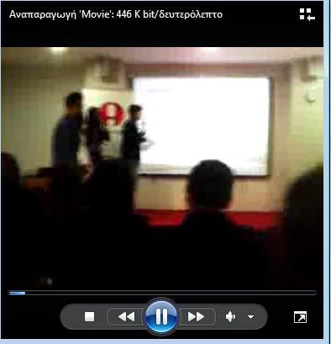
Our Video
Παρουσίαση στο New York College Καλλιθέα

